Slide 1
Recitation 5

Slide 2
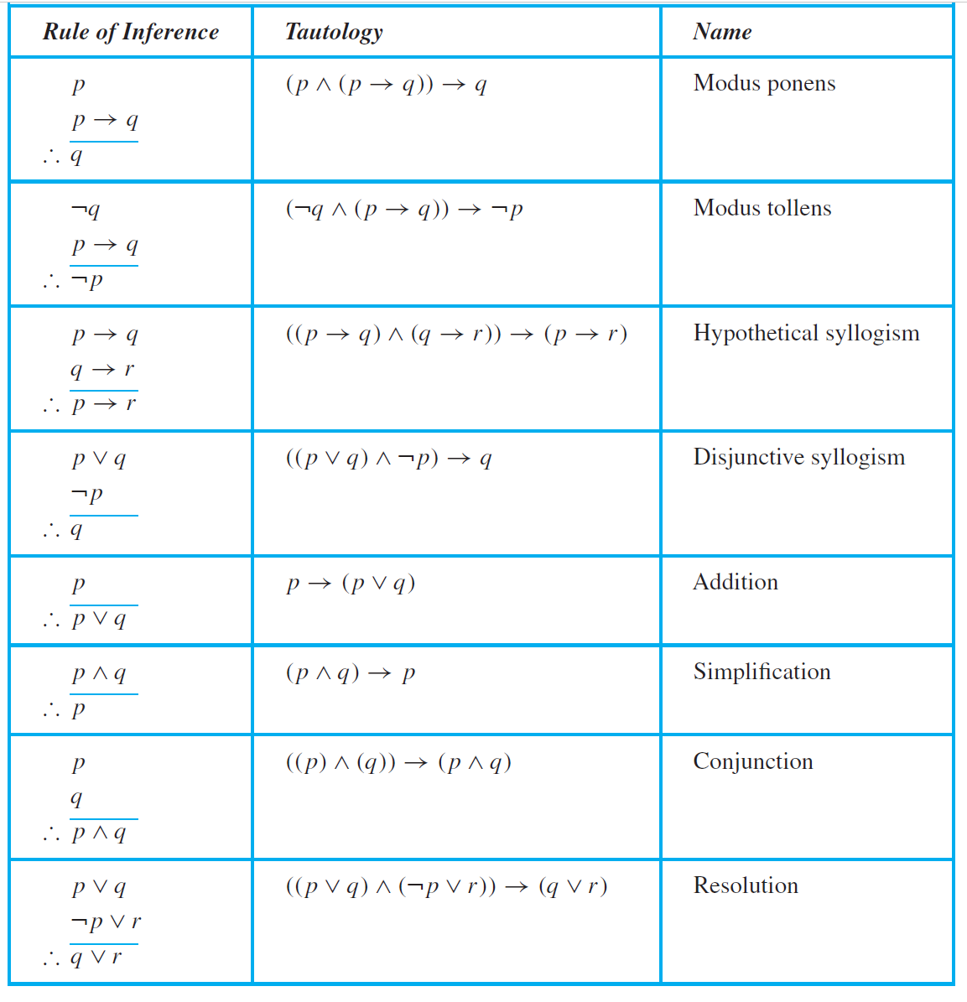
Recitation Schedule
Problems from Chapter 1.6!

Slide 3
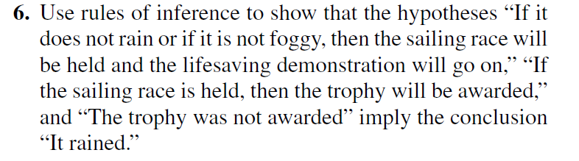
1.6 #6
Notes:
Let’s create some propositional variables
r = it is raining
f = it is foggy
l = there is a lifesaving demonstration
s = the sailing race is held
t = the trophy is awarded
What are our premises?
“If it does not rain or if it is not foggy, then the sailing race will be held and the lifesaving demonstration will go on”:
(¬r ∨ ¬f) → (s ∧ l)
“If the sailing race is held, then the trophy will be awarded”:
s → t
“The trophy was not awarded”
¬t
We want to prove: r
Basically, simplify all the premises in a way to get r
Start with the smallest premise first.
¬t
Let’s look at the second smallest premise.
s → t
Modus tollens: because ¬t, and s → t then ¬s
Let’s look at the largest premise now.
(¬r ∨ ¬f) → (s ∧ l)
We have ¬s, so we want to try to find a way to use it in the largest premise. We want to uses premises to simplify other premises.
Let’s try to build ¬s up in a way for us to use in the larger premise
Addition: ¬s ∨ ¬l
DeMorgan’s: ¬(s ∧ l)
Take a look at the largest premise (¬r ∨ ¬f) → (s ∧ l)
Modus Tollens: Given ¬(s ∧ l) , this implies ¬(¬r ∨ ¬f)
DeMorgan’s: r ∧ f
Simplification: r
Q.E.D

Slide 4
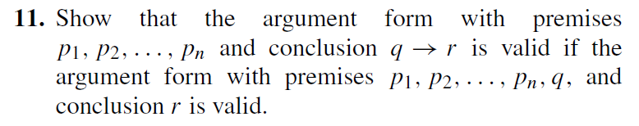
1.6 #11
Notes:
If all premises are true, then the conclusion is true
Given
p₁
p₂
…
p_{n}
q
_____
∴ r
What variable should we look at here? q
Trying to prove:
p₁
p₂
…
p_{n}
_______
∴ q → r
Re-looking at the given statement, we can write the premises as the following: (p₁ ∧ p₂ ∧ … ∧ p_{n} ∧ q)
Because all premises must be true in order for r to be true
Simplification: We can simplify the premises as the following: q
This is because if q is false then (p₁ ∧ p₂ ∧ … ∧ p_{n} ∧ q) and if q is true then (p₁ ∧ p₂ ∧ … ∧ p_{n} ∧ q) is true
So now we have the following:
q
Let’s look at the premise:
q → r
Modus Ponens:
Q
Q → r
_____
∴ r

Slide 5
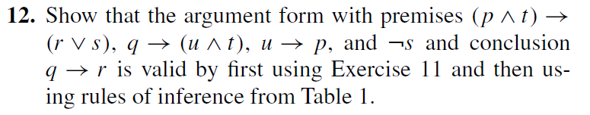
1.6 #12
Notes:
In exercise 11 we showed:
(p ∧ t) → (r ∨ s)
q → (u ∧ t)
u → p
¬s
_______________
∴ q → r
is valid if...
(p ∧ t) → (r ∨ s)
q → (u ∧ t)
u → p
¬s
q
_______________
∴ r
Trying to prove:
(p ∧ t) → (r ∨ s)
q → (u ∧ t)
u → p
¬s
q
_______________
∴ r
Let’s take a look at the smallest premises (u → p, ¬s, q). They’re as simple as they can get so let’s take a look at the second largest premise.
q → (u ∧ t)
q
q → (u ∧ t)
Modus Ponens: (u ∧ t)
Simplification: u, t
Now we have:
u
u → p
Modus Ponens: p
Conjunction: p ∧ t
Now we have:
p ∧ t
(p ∧ t) → (r ∨ s)
Modus ponens: (r ∨ s)
Now we have:
(r ∨ s)
¬s
Disjunctive syllogism: r

